Slide 1
Counter Movement Jump
Ian, Kai-Jen, Kevin, Nick

Slide 2
Introduction
Vertical Jump is a key indicator of lower body strength and is used in many sport settings. This research focuses on how the task instruction can change the outcome of a vertical jump.
One participant was knowledgeable about the questions and goals and the other was blind and just given basic instruction
Verbal instructions may have implications to vertical jump outcome metrics

Slide 3


Method
100 Hz by a 8-camera optical motion capture system
(Theia 3D, Theia Markerless Inc., Kingston, ON )
1200 Hz by 1 force plate
(Bertec Corp.; Columbus, OH, USA )

Slide 4
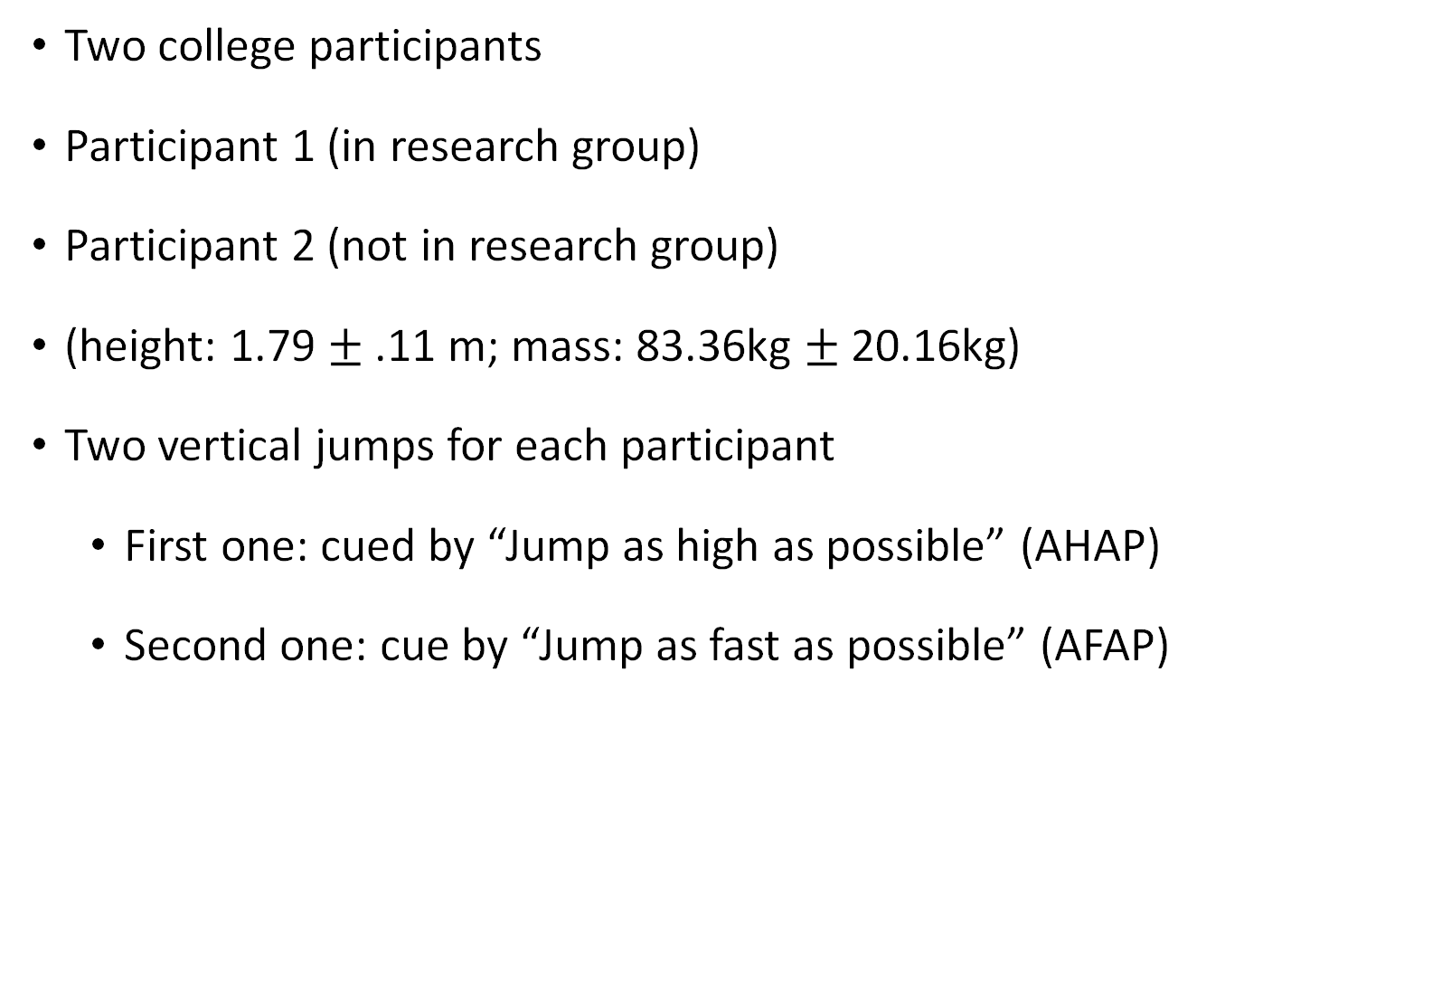
Method
Two college participants
Participant 1 (in research group)
Participant 2 (not in research group)
(height: 1.79 $±$ .11 m; mass: 83.36kg $±$ 20.16kg)
Two vertical jumps for each participant
First one: cued by “Jump as high as possible” (AHAP)
Second one: cue by “Jump as fast as possible” (AFAP)

Slide 5
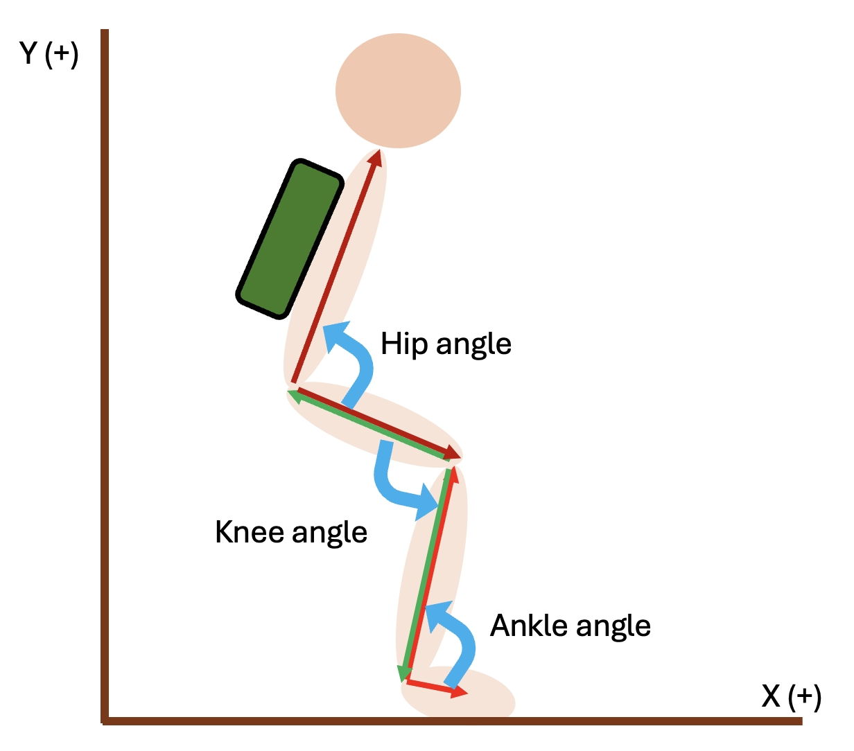
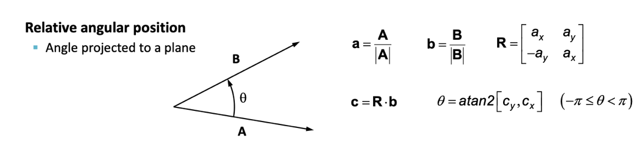
Method
Data processes:
Filter data: 4th zero lag Butterworth low pass filtering
cutoff frequency = 6Hz for motion data / 20Hz for force plate data
Calculate knee flexion / extension angle following the previous homework
(relative angles)
Calculate knee angular velocity with angle respect by the time interval
Calculate jump height by impulse method
Calculate impulse by integral
Normalized ground reaction force (GRF) and impulse by body weight (BW)
Knee flexion / extension

Slide 6
Method
Event setting
# START =
the start of the jump
(GRF < 95% BW )
# MIN_GRF_Y = minimum vertical GRF
# Back to BW =
GRF goes up to equal to the BW after min vertical GRF
# Botton point =
lowest point of the jump
( maximum knee flexion angle)
# Take Off =
GRF < 10% BW
# Touch Down =
GRF > 0.1 BW after take off

Slide 7
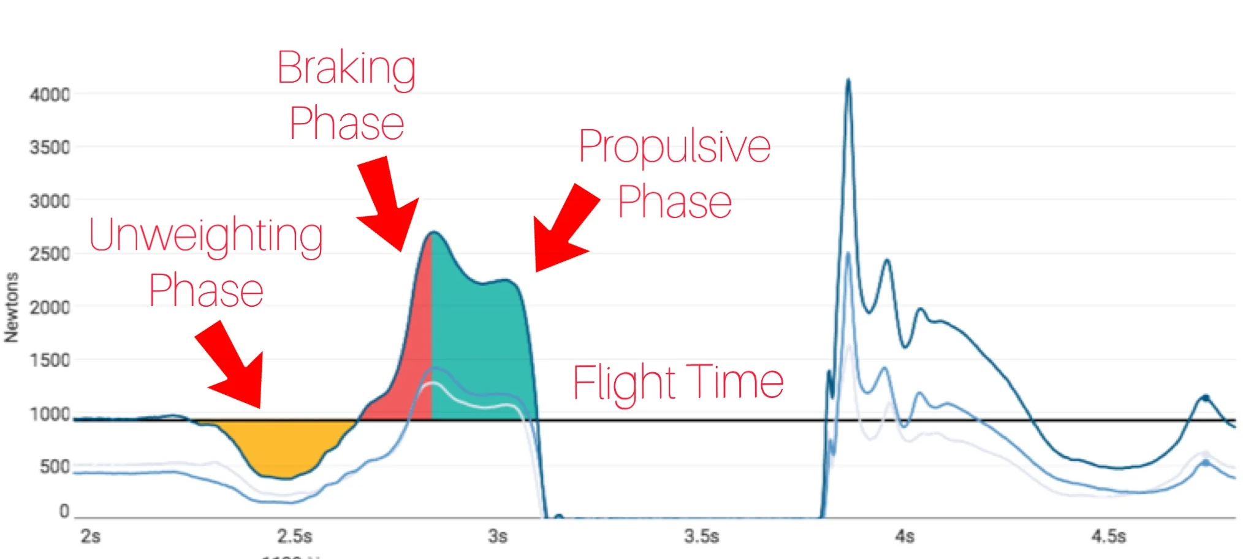
Time interval (sec)
Braking phase

Slide 8
Method – Report parameters
Kinematics
1. maximum knee flexion angle (degree)
2. max knee flexion angular velocity (degree / s)
Kinetics
1. max vertical GRF before take off (N/BW)
2. breaking impulse (J/BW)
3. propulsion impulse (J/BW)

Slide 9
Kinematic Results (Participant 1)
“Jump as high as possible” (AHAP)
“Jump as fast as possible” (AFAP)
 | AHAP | AFAP
Jump Height(m) | 0.43m | 0.41m
Max Knee Flexion Angle(degree) | 80.53° | 115.34°
Max Knee Flexion Velocity(degree / sec) | -230.95 deg/sec | -338.71 deg/sec

Slide 10
Kinetic Results (Participant 1)
“Jump as high as possible” (AHAP)
“Jump as fast as possible” (AFAP)
 | AHAP | AFAP
Max Vertical GRF (N/BW) | 2.33 N | 2.81 N
Breaking Impulse (J/BW) | .16 J | .31 J
Propulsive Impulse (J/BW) | .65 J | .45 J

Slide 11
Time Series Results (participant 1)
“Jump as high as possible” (AHAP)
“Jump as fast as possible” (AFAP)
 | AHAP | AFAP
Unweight time (sec) | 0.53 | 0.38
Breaking time (sec) | 0.18 | 0.15
Propulsion time (sec) | 0.33 | 0.20
Flight time (sec) | 0.60 | 0.59
Total time (sec) | 1.45 | 1.17

Slide 12
Kinematic Results (Participant 2)
“Jump as high as possible” (AHAP)
“Jump as fast as possible” (AFAP)
 | AHAP | AFAP
Jump Height(m) | 0.24m | 0.22m
Max Knee Flexion Angle (degree) | 89.82° | 89.3°
Max Knee Flexion Velocity (degree / sec) | -263.42 deg/sec | -226.64 deg/sec

Slide 13
Kinetic Results (Participant 2)
“Jump as high as possible” (AHAP)
“Jump as fast as possible” (AFAP)
 | AHAP | AFAP
Max Vertical GRF (N/BW) | 2.29 N | 2.29 N
Breaking Impulse (J/BW) | .09 J | .04 J
Propulsive Impulse (J/BW) | .51 J | .53 J

Slide 14
Time Series Results (participant 2)
“Jump as high as possible” (AHAP)
“Jump as fast as possible” (AFAP)
 | AHAP | AFAP
Unweight time (sec) | 0.48 | 0.44
Breaking time (sec) | 0.15 | 0.12
Propulsion time (sec) | 0.28 | 0.27
Flight time (sec) | 0.45 | 0.43
Total time (sec) | 1.2 | 1.16

Slide 15
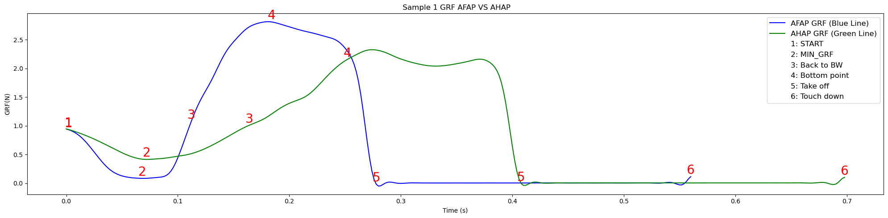
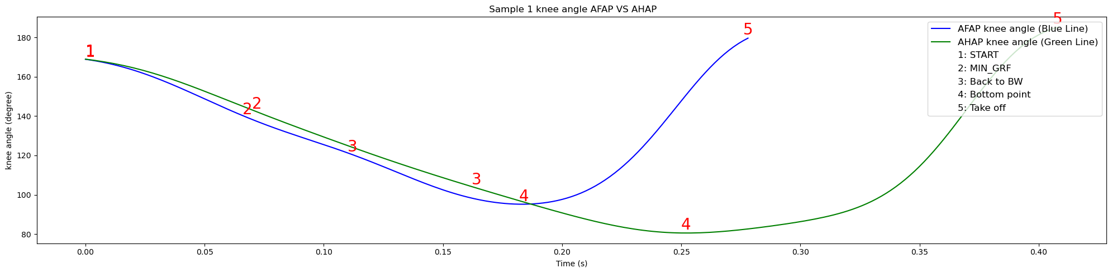
Results – Participant 1

Slide 16
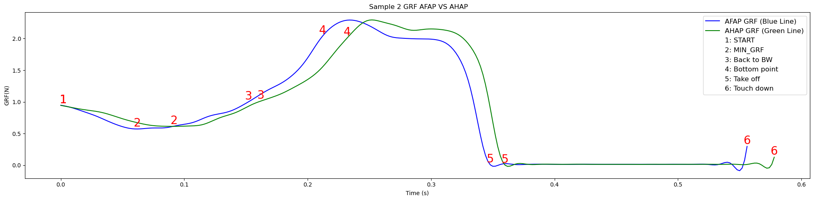
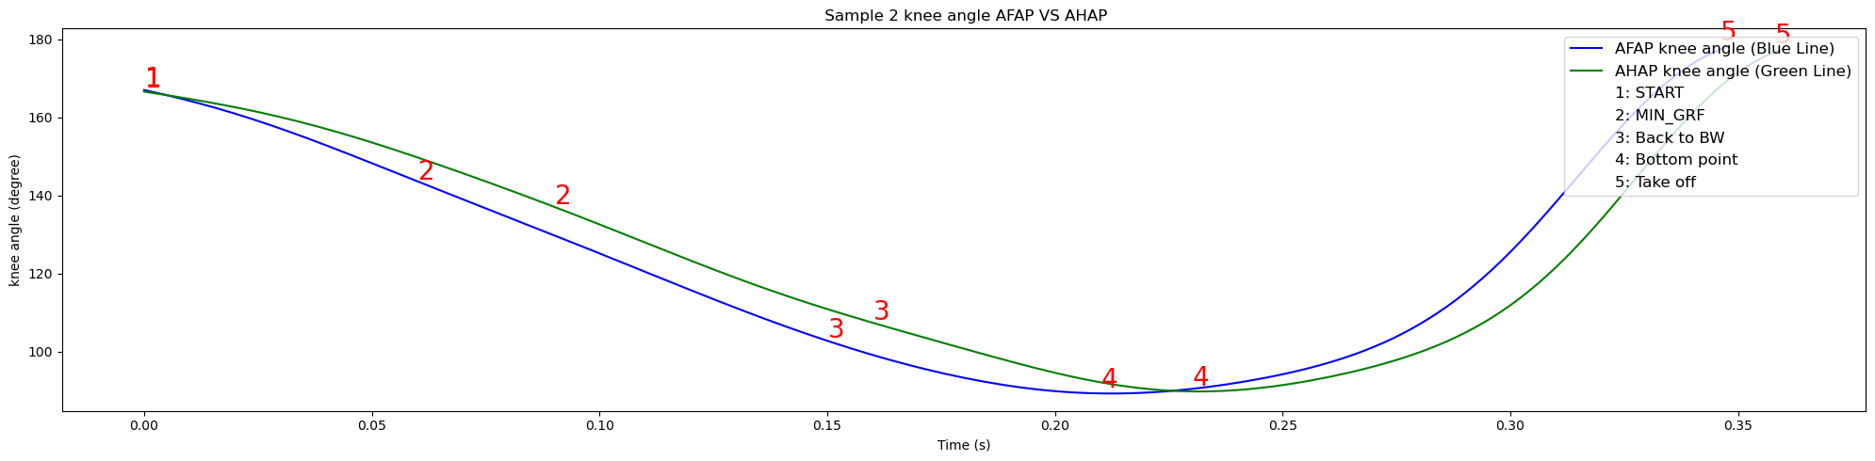
Results – Participant 2

Slide 17
Results
When comparing the two groups of those who knew the outline of the study and those who only were given the instructions the comparisons are vastly different. In the group participants both variables led to vastly different results, while despite the differing instructions the out-group participant's two vertical jumps were almost identical
This brings to question if previous vertical jump experience as well as previous task knowledge influences counter movement jump outcomes.

Slide 18
Potential Reasons for Results
Participant experience level
Understanding task instructions (may be related to experience level)
No warmup

Slide 19
Future Research
Continue to look at task instruction and effects on CMJ metrics
Try different instruction cues to see if results differ

Slide 20


Questions?

